Slide 1
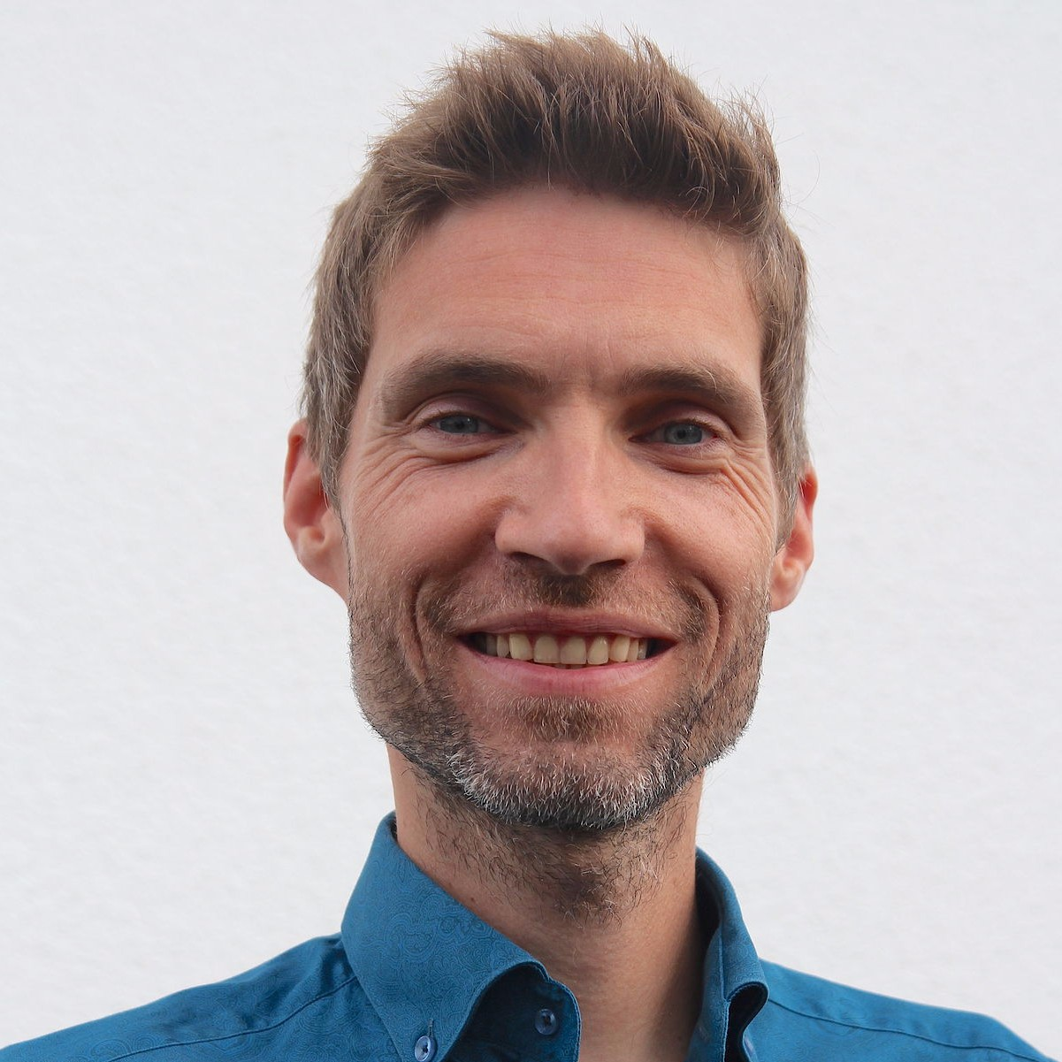
how Business Analysis
can make change stick
Filip Hendrickx

Slide 2


are you a change maker?
images by Gordon Johnson on Pixabay
Notes:
Are you a change manager?
Are you a change maker?
Every project is a change project
Every person on a project is a change maker
Just like “everyone is in sales,” “everyone is in change.”
My change talk's ORS → Are we aware, and are we equipped for this?
We better come prepared.
Some tools & techniques
An outlook on how we shape our organisations & people to be better in handling change

Slide 3

what do I know about change?
(except that it’s tough and people usually don’t like it)
photo by Priscilla Du Preez on Unsplash
Notes:
Everyone of you triggers and undergoes changes, big and small, every day of your life.
Graduate, buy a house, get married and have children, change careers, COVID
Some examples of seemingly small, sometimes almost daily, changes: change where we sit at the table ⇒ Lively discussions!
Consciously thinking about these changes, tap into your own, personal experiences: what they did to you and how you reacted, what they did to others and how they reacted, is a wealth of information to tap into and to become a better agent of change
This talk is not a definitive guide to change, but rather a collection of personal thoughts, ideas, experiences, reflections, suggestions … from a BA’s perspective → So let’s have a look at some tools. :-)

Slide 4
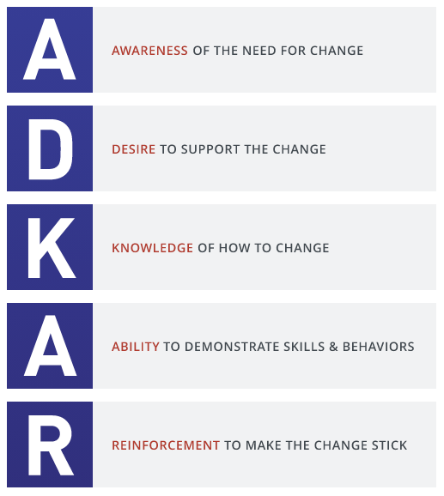
source: Prosci — What’s the ADKAR model?
Notes:
Securex example
New process, new sales approach for non-sales people
Ensure feasibility: product knowledge, practical stuff, legal stuff, available time
Work with champions
...
An model to help us manage the change, the process of introducing the change.
What I’ve learned: Genuine concerns about helping the customer, providing the right advice, products and services, so that the customer is well protected → They genuinely cared.

Slide 5
sarah model
+
hope
shock
state of mind
anger
time
acceptance
-
resistance
Notes:
Focus often tends to be managing the change.
What about emotions and feelings that people experience when they (need to) change?
This is the other side of the change coin, next to the rational side ADKAR.
Example
Covid
Family trip to Orlando & luggage challenge
Change is a crisis spread out over time.
https://www.intepeople.co.nz/leading-change-sarah/
https://www.mindtools.com/pages/article/newPPM_96.htm

Slide 6


Slide 7


how does change feel?
photo by Mae Mu on Unsplash
Notes:
Cf. quote: “I've learned that people will forget what you said, people will forget what you did, but people will never forget how you made them feel.” ― Maya Angelou, civil rights activist
Both models focus on managing the change. It’s a very rational and managerial approach to handling/enforcing change. Is that good enough?
As analysts, we spend a lot of time dealing with the rational side of change. What about the emotional side of change?
What does change do to people? How does it make them feel? Only by feeling/experiencing you will truly understand.
Think about yourself: When was the last time you did something for the first time? → Use that awareness when dealing with the changes you are involved in.
Be more conscious about change yourself: how you experience it, how you trigger it. Ask people how they think and feel about it, what they do and say about it.
Change is a crisis spread out over time.
Change causes fear -> fear blocks certain ways of thinking - cf. Emergence magazine March 2021 p. 6
Fear and anger are strong emotions that hijack our brain: they flood it with serotonin which in turn overrides our seeking system, the part of our circuitry responsible for exploration and learning, the part which we need the most when solving complex problems. Fear blocks our thinking, prolonging the time needed for solving a problem or handling/trying something new. This slow down can cause more fear.
Viewpoint from conversation: “What does this situation do to that person? How does it make him or her feel?”

Slide 8

empathy map
says
thinks
does
feels
source: Updated Empathy Map Canvas — Empathy Mapping
Notes:
https://medium.com/the-xplane-collection/updated-empathy-map-canvas-46df22df3c8a
https://www.nngroup.com/articles/empathy-mapping/

Slide 9
he’s crazy
“I was expecting something different”
duh!
says
thinks
does
feels
empowered
lean forward
overwhelmed

Slide 10
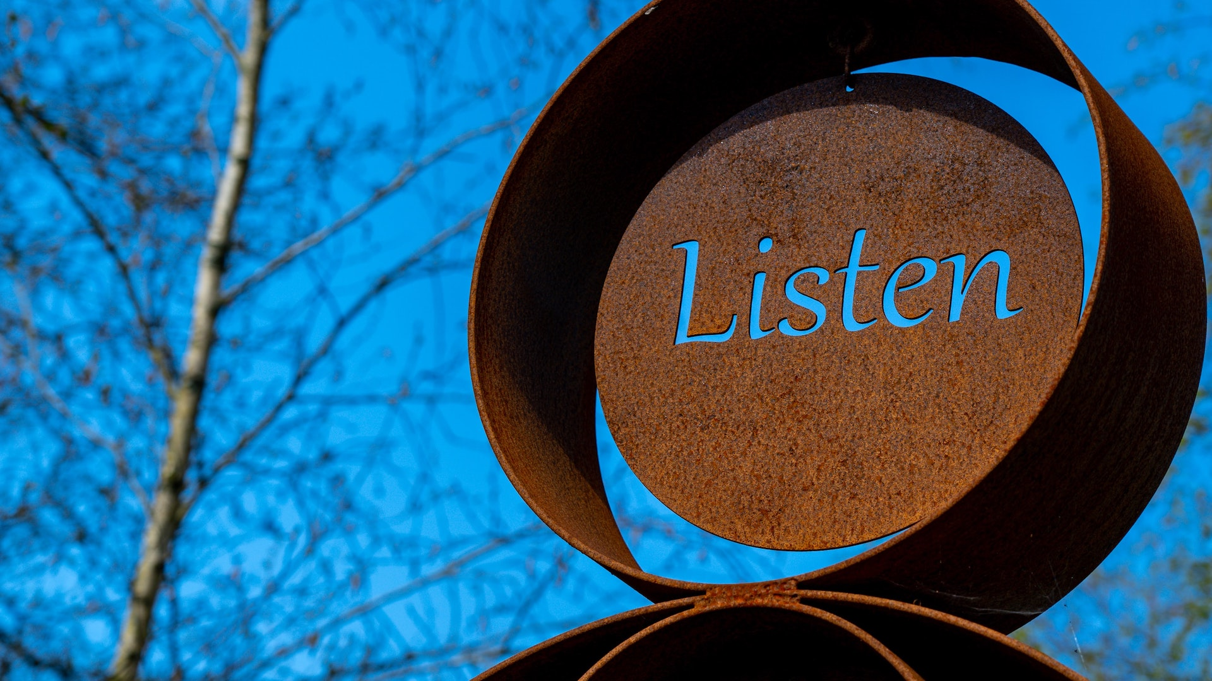
deep listening
why will it (not) work? ● yes, and …
photo by Nick Fewings on Unsplash
Notes:
Better understanding of the resistance to change (if we want to suggest another solution)
Shift: listening to capture and prioritise → listening to understand
During requirements elicitation
Stakeholders usually have a preconceived idea about the problem and the solution. Defer judgement (“I don’t want to know your solution, I want to know your problem.”), find out why they believe what they say.
Deep listening is a process of listening to learn. It requires the temporary suspension of judgment, and a willingness to receive new information – whether pleasant, unpleasant, or neutral.
Example: mobile banking native app, not web app → why? outsource development to be less dependent on internal IT department
Why does a stakeholder believes his idea will work? (Notice the word “will”, not “would”.)
Technique: user story: add focus to “why would it work?”

Slide 11

make it safe
what is good enough for now and safe enough to try?
photo by Loic Leray on Unsplash
Notes:
change → new territory → fear
te moeilijk, science fiction / onrealistisch, … → kleine, concrete stappen
relatief
ervaring
aanvoelen
taalgebruik: problem/challenge/opportunity or risk/uncertainty/learning/potential
safety measures
vooraf: vb doelgroep beperken of afbakenen, communicatie - vb TA Car Insurance interne survey
achteraf (maar voorbereid): wat kan er “fout” gaan en hoe gaan we hierop reageren?
stapsgewijs opbouwen van experimenten
Technique: small steps / “scope” decomposition (functional scope, reach (people, geographical, …), …)
different “type” of requirements, but requirements nonetheless

Slide 12
are we ready for change?
✅
already doing it
🚀
let’s do this!
🤔
maybe, need to think
🙅
no way!
Notes:
already → We’re already on our way to the future!
let’s → A great starting point to move forward!
maybe, no way → Share concerns, blocking factors, past experiences, … → Initiate a safe conversation
The first two let us ease our way into the last two, or we may discover they are already enough to let us reach our goals.

Slide 13

keep your/their eyes on the prize
what would have to be true?
photo by Charles Deluvio on Unsplash
Notes:
Positive, engaging question
Shift:
output → outcome → purpose
cf. Simon Sinek “Start with Why”
deadline ⇒ pressure ⇒ focus on output delivery → outcome realisation + checking change related needs
Technique: benefit map

Slide 14
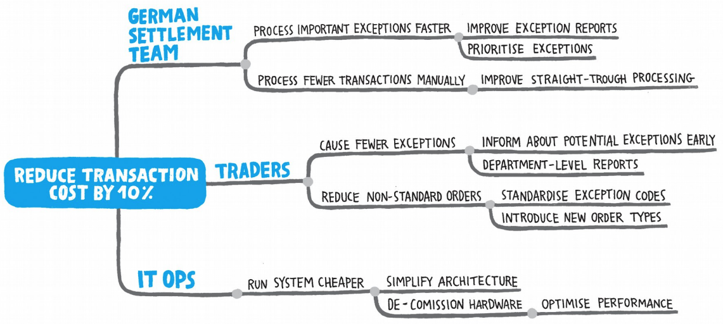
source: Impact Mapping — Gojko Adzic
Notes:
Shift: output → outcome
Why = goal → Who = actor → How = impact → What = solution
Before the project:
Co-discovering the rationale for change
With customers
Co-specifying the goals of the change → giving ownership of the goals, providing the support that is needed
Impact map + Benefit dependency network are more explicit about change
Who is impacted & Who can help
During = After the project:
Are you achieving your goals? If not, don’t just keep on implementing scope.
Impact maps and Benefit dependency networks are examples of benefit maps that explicitly show people and changes
Short feedback loops on business outputs and outcomes
Build learning into the loops and the way business works: shift away from a fixed as is and a fixed to be

Slide 15
change management
+
hope
shock
state of mind
anger
time
acceptance
-
resistance
Notes:
Those were “tools” to explain the change, empathise and understand people’s reactions.
We often use these to help us manage the change, manage people through change. To flatten and shorten the change curve people go through.
Is that the right/only/best focus?
Often, the harder you push, the harder people will push back.
https://www.intepeople.co.nz/leading-change-sarah/
https://www.mindtools.com/pages/article/newPPM_96.htm

Slide 16
People don't resist change. They resist being changed.
— Peter M. Senge
scientist, lecturer, author on organisational development and learning organisations
Notes:
https://en.wikipedia.org/wiki/Peter_Senge
You cannot change people. People can only change themselves. But you can help them with that.
Making the shift from defining and then managing change, to co-creating change. → This is where BA can shine!
Let’s dive into the BA toolkit and look at some of our techniques to a “co-creating change lens”.
Example: Securex: People had a lot of questions and concerns, but ultimately, they really wanted to do well for their customer.
Alternative quote: "A change imposed is a change opposed" — Dr. Spencer Johnson
Would it be possible to follow an approach where we are not changing people…?

Slide 17
(facilitating) co-creation
keep satisfied
key stakeholders
sponsor
legal
finance
power
marketing
customer
HR
operational staff
minimum effort
keep informed
interest
source: BrainyGlue.com
Notes:
Shift: manage project stakeholders → involve business stakeholders
From project perspective, customers and operational staff may be of low importance. From business success perspective, they are often key.
Co-create with people from across the entire organisation
Shift: elicit, analyse, summarise, design → connect and enable co-creation
Not a one-time interview, but true collaboration and co-creation
BAs are the spider in the web, connecting everyone and everything
Slow? African proverb: If you want to go fast, go alone. If you want to get far, go together.

Slide 18

be a spider
photo by Nicolas Picard on Unsplash
Notes:
Coming back to the beginning: BAs playing a crucial role in strategy execution & realisation: what is this role exactly, given this new context of team collaboration?
As a BA, we’re not the bridge (between business and IT) anymore, that creates a bottleneck and hinders flow.
We’re not the central hub between spokes anymore either, as it would still leave all conversations to go through us.
We should build / facilitate a web of connectivity, where information flows and collaboration grows.
We move from a knowledge expert role to (also) a facilitator role.
As BA, we also help creating a psychologically safe environment e.g. in workshops.
We “inject” the BA mindset in all people around us.
Facilitate the process, the web of communication, and results through shared understanding will follow.
Cf. holism, systems thinking (cf. Stefan, Nick) → Who takes care of the whole? Analysis → Synthesis, cf. talk Nick de Voil @ BBA2021
BA coach
workshop facilitator
contents
process (for example: introverts vs extraverts)

Slide 19
Kurt Lewin’s Model Of Change
unfreeze
change
refreeze
Notes:
AS IS → TO BE
Are we facilitating the detailed design, implementation and roll-out of a predefined change that is then fixed until the next change comes along?
Cf. projects: beginning and end
What if we need to change more quickly? What if we need to react more quickly to changes in our environment?

Slide 20

changeable by design?
photo by Håkon Grimstad on Unsplash
Notes:
or chameleon
predefined change or transformation
change built in → changeability built in = adaptive systems
manage people through change → co-create change with people → enable and stimulate people to make change themselves
small, co-owned “system” designs and solutions + continuous feedback, learning and improvement → change becomes a constant
quite clear what this means for software: configuration and parameterisation, more advanced: (micro)services
what does this mean for non-automated parts of our business? manual process steps, …
procedures, business rules, … → how strict? how fixed?
Securex: local office differences, within certain guidelines / constraints (vs “computer says no”)
Eneco voorbeeld support die klanten kan bedanken (??)
this is still pre-determined/pre-programmed “change” → can we go beyond this?

Slide 21

when change isn’t strange
source: The Guardian — Chinese flower has evolved to be less visible to pickers
Notes:
When you equip people with the ability and tools to sense and respond to change triggers (transparently provide them with data, information & insights), and enable and empower them to change their way of working themselves (within certain constraints and with clear and shared goals and values in place), then perhaps change won’t be strange anymore.
Shift: command & control → sense & respond
Shift: change from the outside → change from within
Shift: big changes in big bursts (“as is” to “to be”) → continuous small adjustments
Change is a crisis spread out over time → A crisis is (just) a series of changes compressed in a short period of time
Example: Unambiguous process flows? Always?
Example: The many roles BAs take throughout projects (analysis, design, test, roll-out; also leader, guide, follower, facilitator, listener/psychologist, …)
(Small) change is a constant → continuous evolution becomes a habit
Change is the new normal
Different from the example of natural evolution, we humans are probably able to make conscious choices about what changes to introduce and how to design them, which is even more powerful.
What “ingredients” do we need to make this work?
people and the flexibility they offer
data & insights so people can (re)act

Slide 22
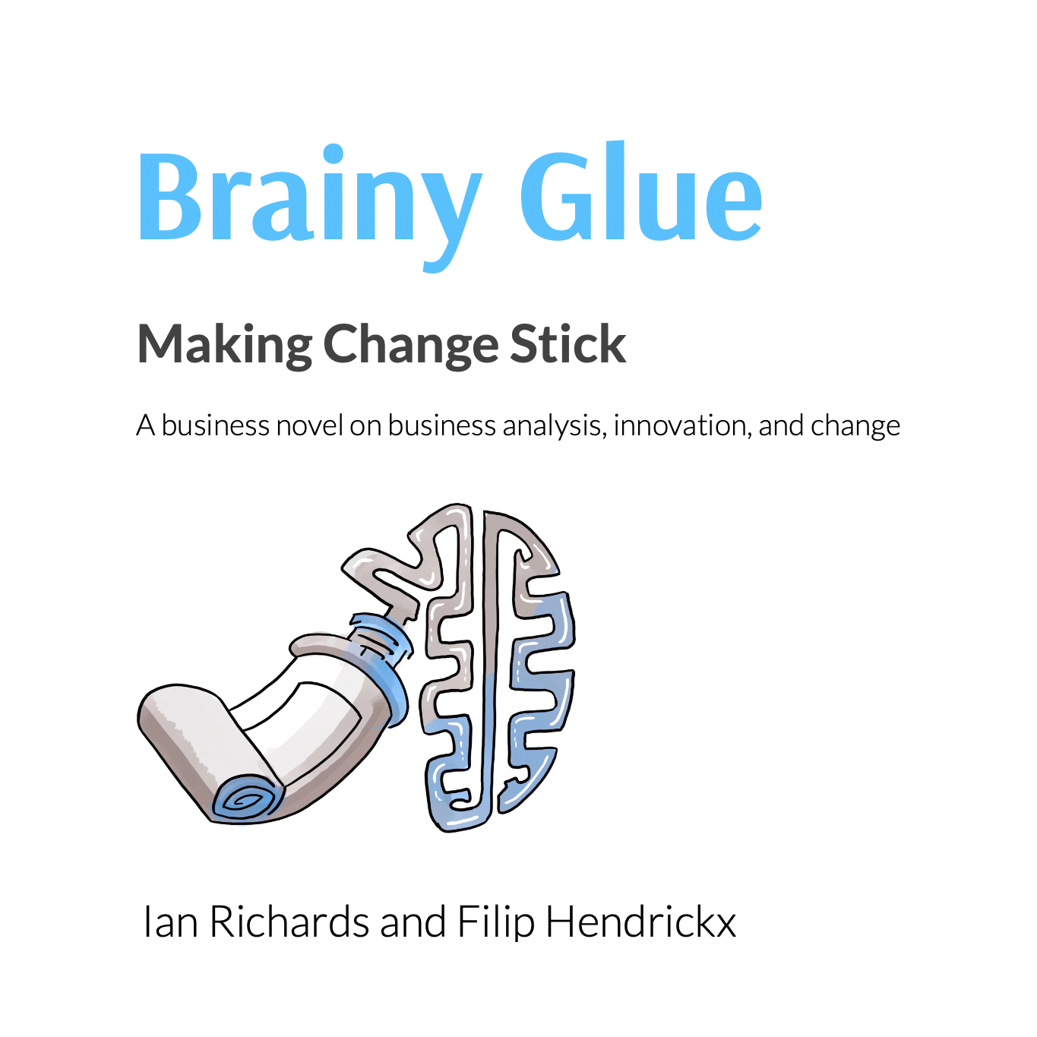
about me
innovating BA altershape
coach trainer speaker author consultant
iiba brussels chapter can-do mentality
www.altershape.eu
filip.hendrickx@altershape.eu
linkedin.com/in/filiphendrickx
BrainyGlue.com
Notes:
Blog
Other workshops
Frequent speaker
IIBA
LI QR?
Get in touch for slides

Slide 23
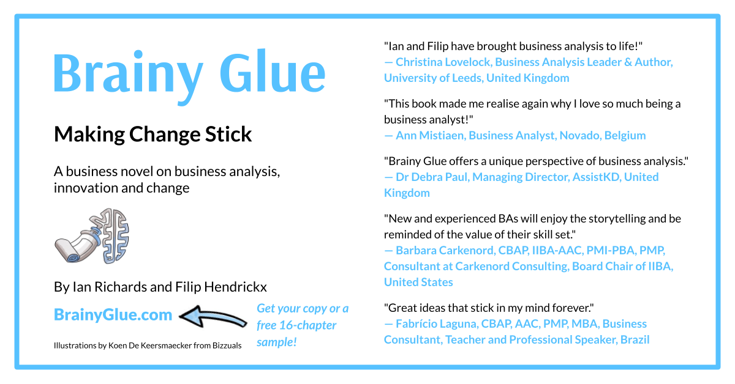

Slide 24





Pořadatel
Děkujeme našim partnerům

Slide 26
seeded questions

Slide 27
every project
is a change project
Notes:
project, product improvement, initiative, …
you are changing something, how people work, internal + external, intentional or unintentional
example of a seemingly small project and the effects of change: spaarlamp?
IIBA BABOK v.3
Business analysis is the practice of enabling change in an enterprise by defining needs and recommending solutions that deliver value to stakeholders. Business analysis enables an enterprise to articulate needs and the rationale for change, and to design and describe solutions that can deliver value.

Slide 28
every person on a project
is a change maker
Notes:
change maker, agent of change
⇒ Whatever your role, you are involved!
As a BA professional (cf. IIBA BABOK definition of business analysis as the practice of enabling change …), you (co-)define the To Be, and thus the change
PO, PdM: prioritise changes
UX/UI designer: shape user experience and changes
Tester: determine which bug and inconveniences must be fixed and which won’t hamper change too much
…
“on a project”, “close to a project”, “in your organisation”, “in the world” (e.g. customers & word of mouth)
Are you conscious of this, the impact on people, and of your role in making the change happen?
But, most of us are not change managers, and people don’t like change, so, what can we do?

Slide 29
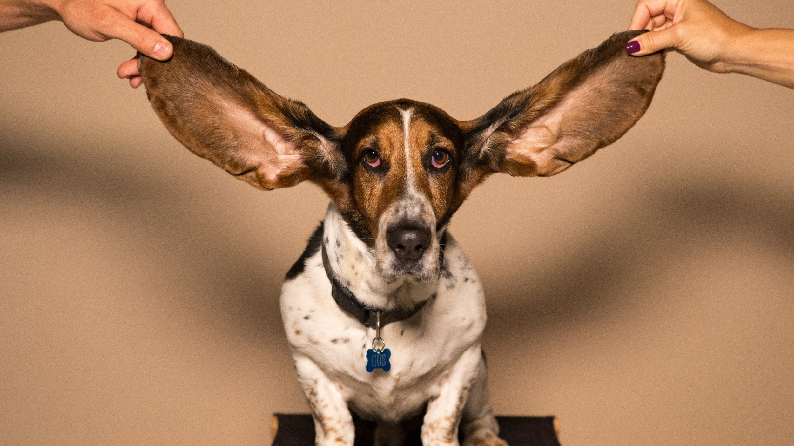
yes, but → yes, and
photo by kyle smith on unsplash
Notes:
! Practice hands-up → Silence !
Pick a stakeholder that is a really bad listener → “Steve never listens so …”
Asking the right questions is not enough. We also need to really listen (and get other people to really listen to each other).
Survey OZ (Belgian mutuality) 2018: 75% of Flemish teenagers says it “would be nice if someone would listen without judging”.
Listening exercise
→ Who thinks listening is hard, takes effort & concentration?
Example: Our kids during dinner → "Don't speak with your mouth full of food."
→ Exercise 1:
Follow your partner’s movement → Listening should require equal amount of concentration
Switch roles
Try to take over
→ Exercise 2: 1 minute of speaking & listening without interruption → How did it feel to be listened to? To listen? Compare with normal meeting behaviour
Listen to understand, not for a chance to escape, to talk, to confirm your view, to hear specific information.
Compare with have a real conversation via text messaging. Often feels like having 2 conversations in parallel. Hard to wait for the other person while he/she’s typing. Compare with online chatting with a support agent: ever had the feeling he/she is having multiple conversations in parallel? Wouldn’t you prefer to have that person’s undivided attention?
As BA: facilitate the conversation between stakeholders, be alert and enable real listening, ensure a psychologically safe environment.
Technique 1: just shut up :)
Technique 2: yes, and
Active listening
Technique 3: evaluate your own “listening quality” after each conversation / ask you conversation partner to evaluate your conversations: how did it feel for him/her?
Dalai Lama
1 mouth vs 2 ears and 2 eyes ⇒ use them according to this ratio
We can listen much more quickly than we can talk, and tend to become impatient as a consequence → be mindful of this and stay focused on listening

Slide 30
keep your eyes on the prize
Gather customer feedback
Build mobile experience (internal)
Features:
account balance
transaction overview
[sharing]
Provide support
Build mobile user base
Create mobile app
Security
Roll-out mobile app
Enrollment (activation)
Build brand image: not a laggard
Promote mobile app
Notes:
Shift: output → outcome
Why = goal → (Who = actor →) How = impact → What = solution
Before the project:
Co-discovering the rationale for change
With customers
Co-specifying the goals of the change → giving ownership of the goals, providing the support that is needed
Framing: “What would have to be true?”
Impact map + Benefit dependency network are more explicit about change
During = After the project:
Are you achieving your goals? If not, don’t just keep on implementing scope.
Impact maps and Benefit dependency networks are examples of benefit maps that explicitly show people and changes
Short feedback loops on business outputs and outcomes
Build learning into the loops and the way business works: shift away from a fixed as is and a fixed to be

Slide 31
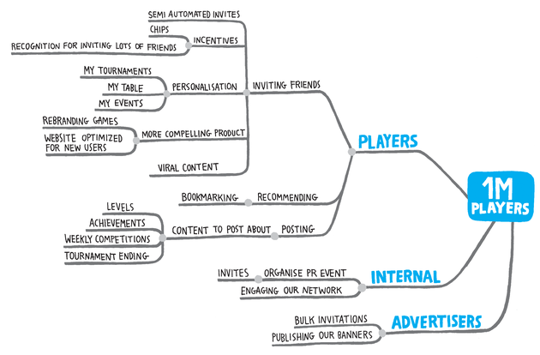
keep your eyes on the prize
source: Impact Mapping — Gojko Adzic
Notes:
Shift: output → outcome
Why = goal → Who = actor → How = impact → What = solution
Before the project:
Co-discovering the rationale for change
With customers
Co-specifying the goals of the change → giving ownership of the goals, providing the support that is needed
Framing: “What would have to be true?”
Impact map + Benefit dependency network are more explicit about change
During = After the project:
Are you achieving your goals? If not, don’t just keep on implementing scope.
Impact maps and Benefit dependency networks are examples of benefit maps that explicitly show people and changes
Short feedback loops on business outputs and outcomes
Build learning into the loops and the way business works: shift away from a fixed as is and a fixed to be

Slide 32
predict/command & control
→ sense & respond
source: The Guardian — Chinese flower has evolved to be less visible to pickers
Notes:
As triggers for changes come faster, we need a new model to deal with these changes, to react.
When it rains, don’t try to command & control the rain to stop. Rather, start selling umbrellas.
Reaction vs Response

Slide 33
picture a difficult change
empathise with impacted people
listen to understand
co-specify the goal
co-create the solution

